Slide 1
From now on, you will see screens that contain instructions about the task.
Read them carefully and press ‘Got It’ button when you finished it.
If you don’t see ‘Got It’ button below, please wait for few seconds. It sometimes takes about a minute to load the pages.

Slide 2
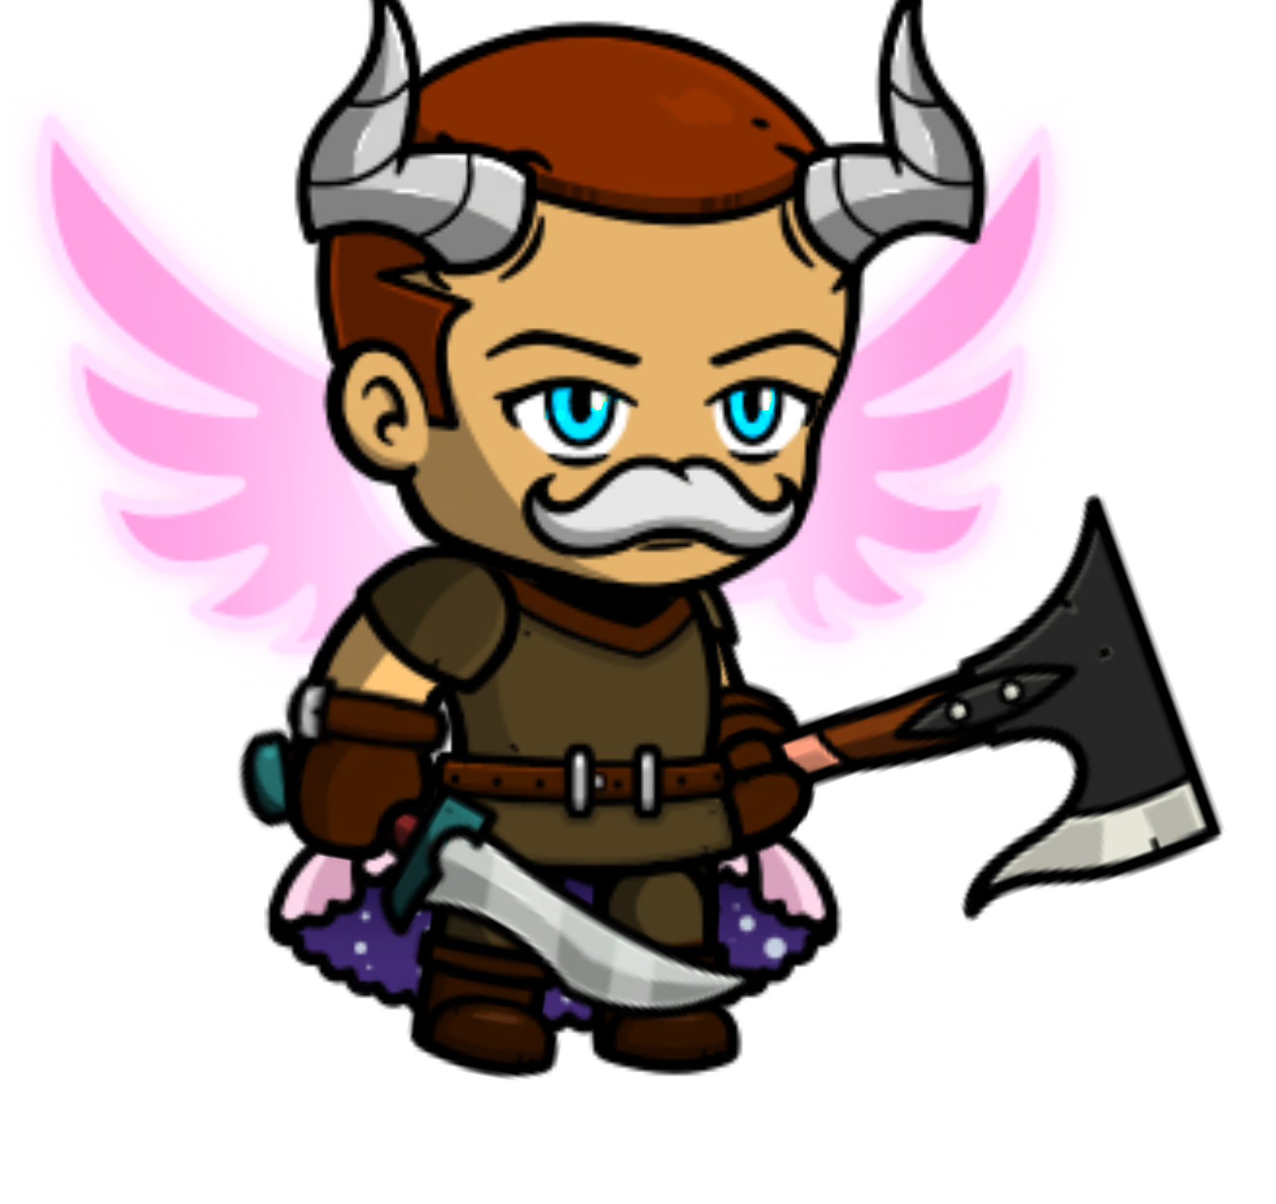
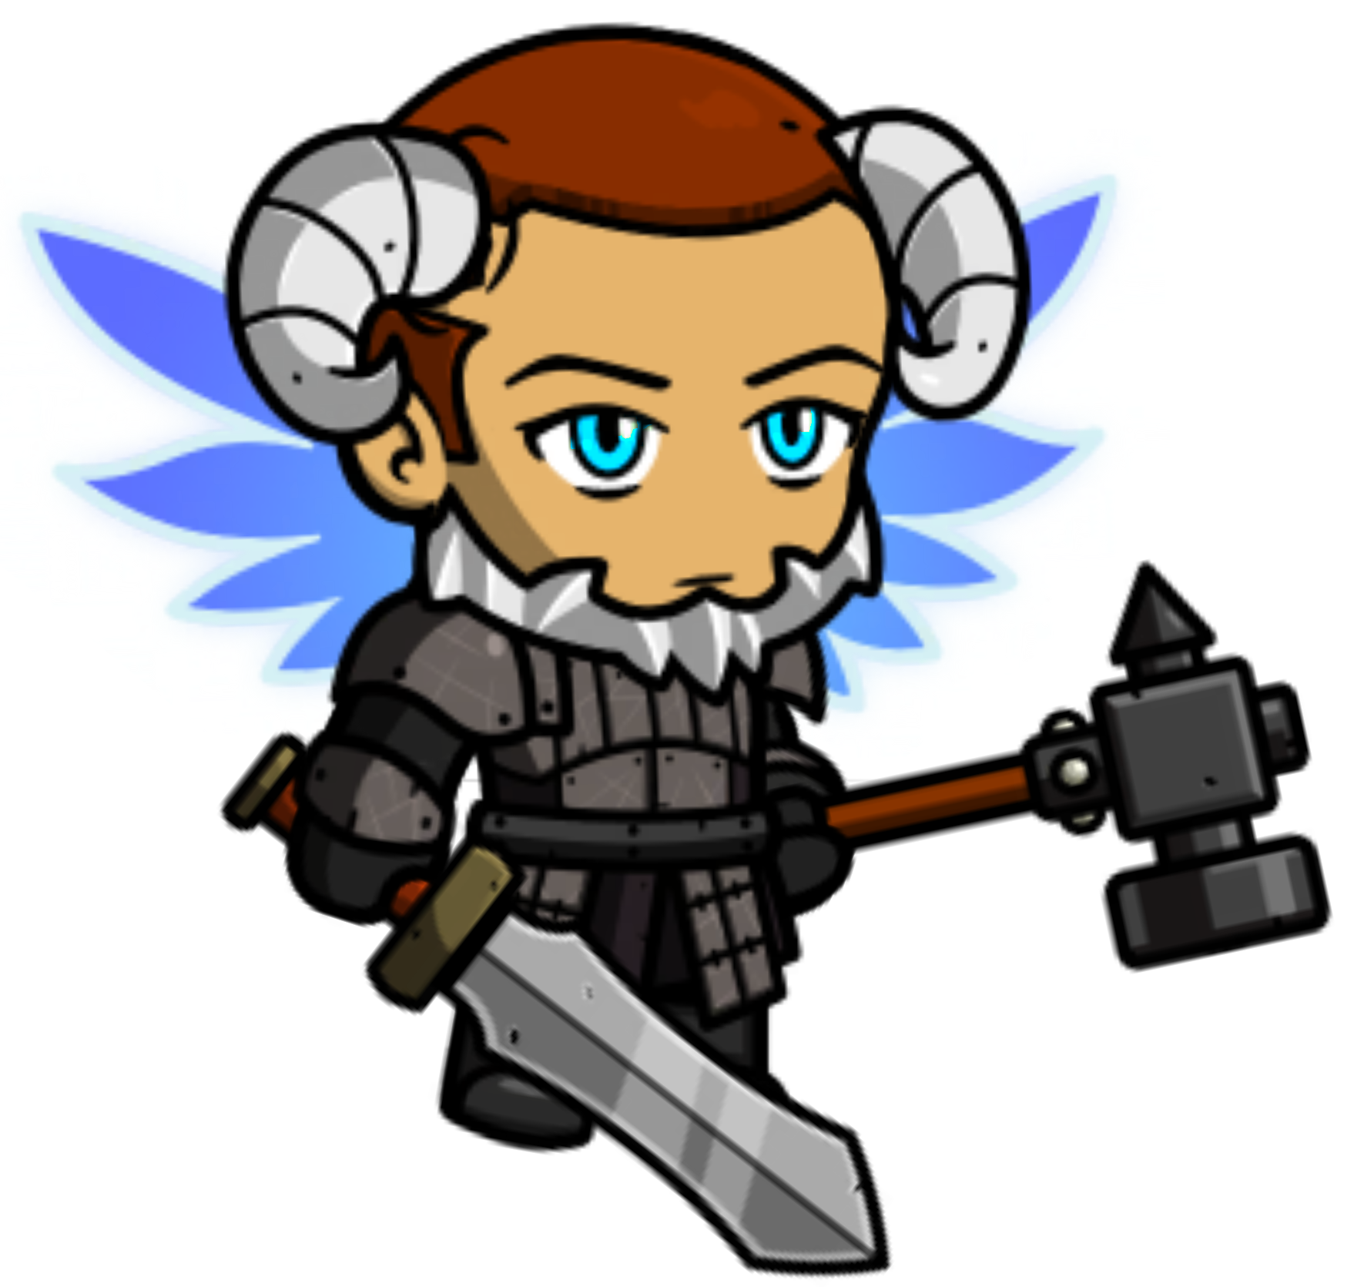
You will see various heroes that vary in their appearance.
Below, you can see examples of heroes with varying appearances.
Here are only two examples, but in the experiment, you will encounter various other heroes, each with distinct appearances.
(1/5)

Slide 3

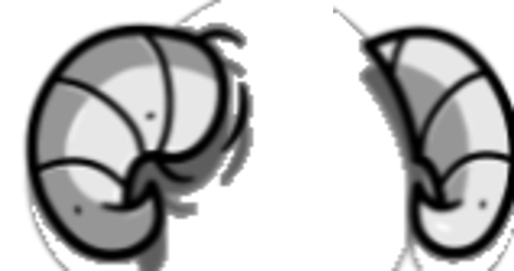
2. In the task, you will first see the clue about the hero’s appearance, and will see a hero.
You need to decide whether a hero is the one you are looking for based on the clue.
A hero
Clue
Is this hero the one you are looking for? (Response)
(1/5)

Slide 4
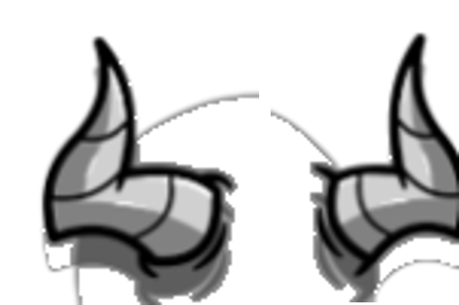
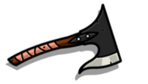






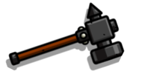


3. Below are the different types of clues you will encounter during the task.
There are six types of clues about the hero’s appearances.
1) Horns, 2) Armor, 3) Wing, 4) Face hair, 5) Hand1, 6) Hand2
(It is very important for the task. Please try to memorize this)
Horns
Armors
Wings
Face
Hand1
Hand2
Upward
Leather
Pink
Mustache
Short (sword)
Axe
Downward
Steel
Blue
Beard
Long (sword)
Hammer
(3/5)

Slide 5
3. A clue will be presented with either ‘text’ or ‘image’.
After you see the clue, you will see a hero.
If a hero is the one you are looking for based on the clue, press ‘D’ button.
If a hero is not the one you are looking for, press ‘K’ button.
Horns = downward
or
Horns are pointing downward.
Press ‘D’!
(3/5)

Slide 6
5. After each trial, you will see visual feedback. You will also see overall accuracy
starting from the second block. Please respond ‘fast’ and ‘accurate’.
If you respond too slow, the trial will consider that trial ‘incorrect’ and move
on to the next trial automatically.
We assess participants’ data based on multiple criteria. If we find any abnormality in your data
(low accuracy, random responses in few blocks, etc), your data might not be accepted.
Correct (Incorrect)
Overall Accuracy: ~%
(5/5)

Slide 7
The second task will be same as the first task, with just a few changes

Slide 8
In this task, you will see two clues about the hero.
However, only one clue is true, and the other clue is false.
This means that the hero you will see should satisfy only one clue, but not the other.
The hero should have
Horns = downward
downward horns
or
pink wings
Wing = pink
(1/4)

Slide 9
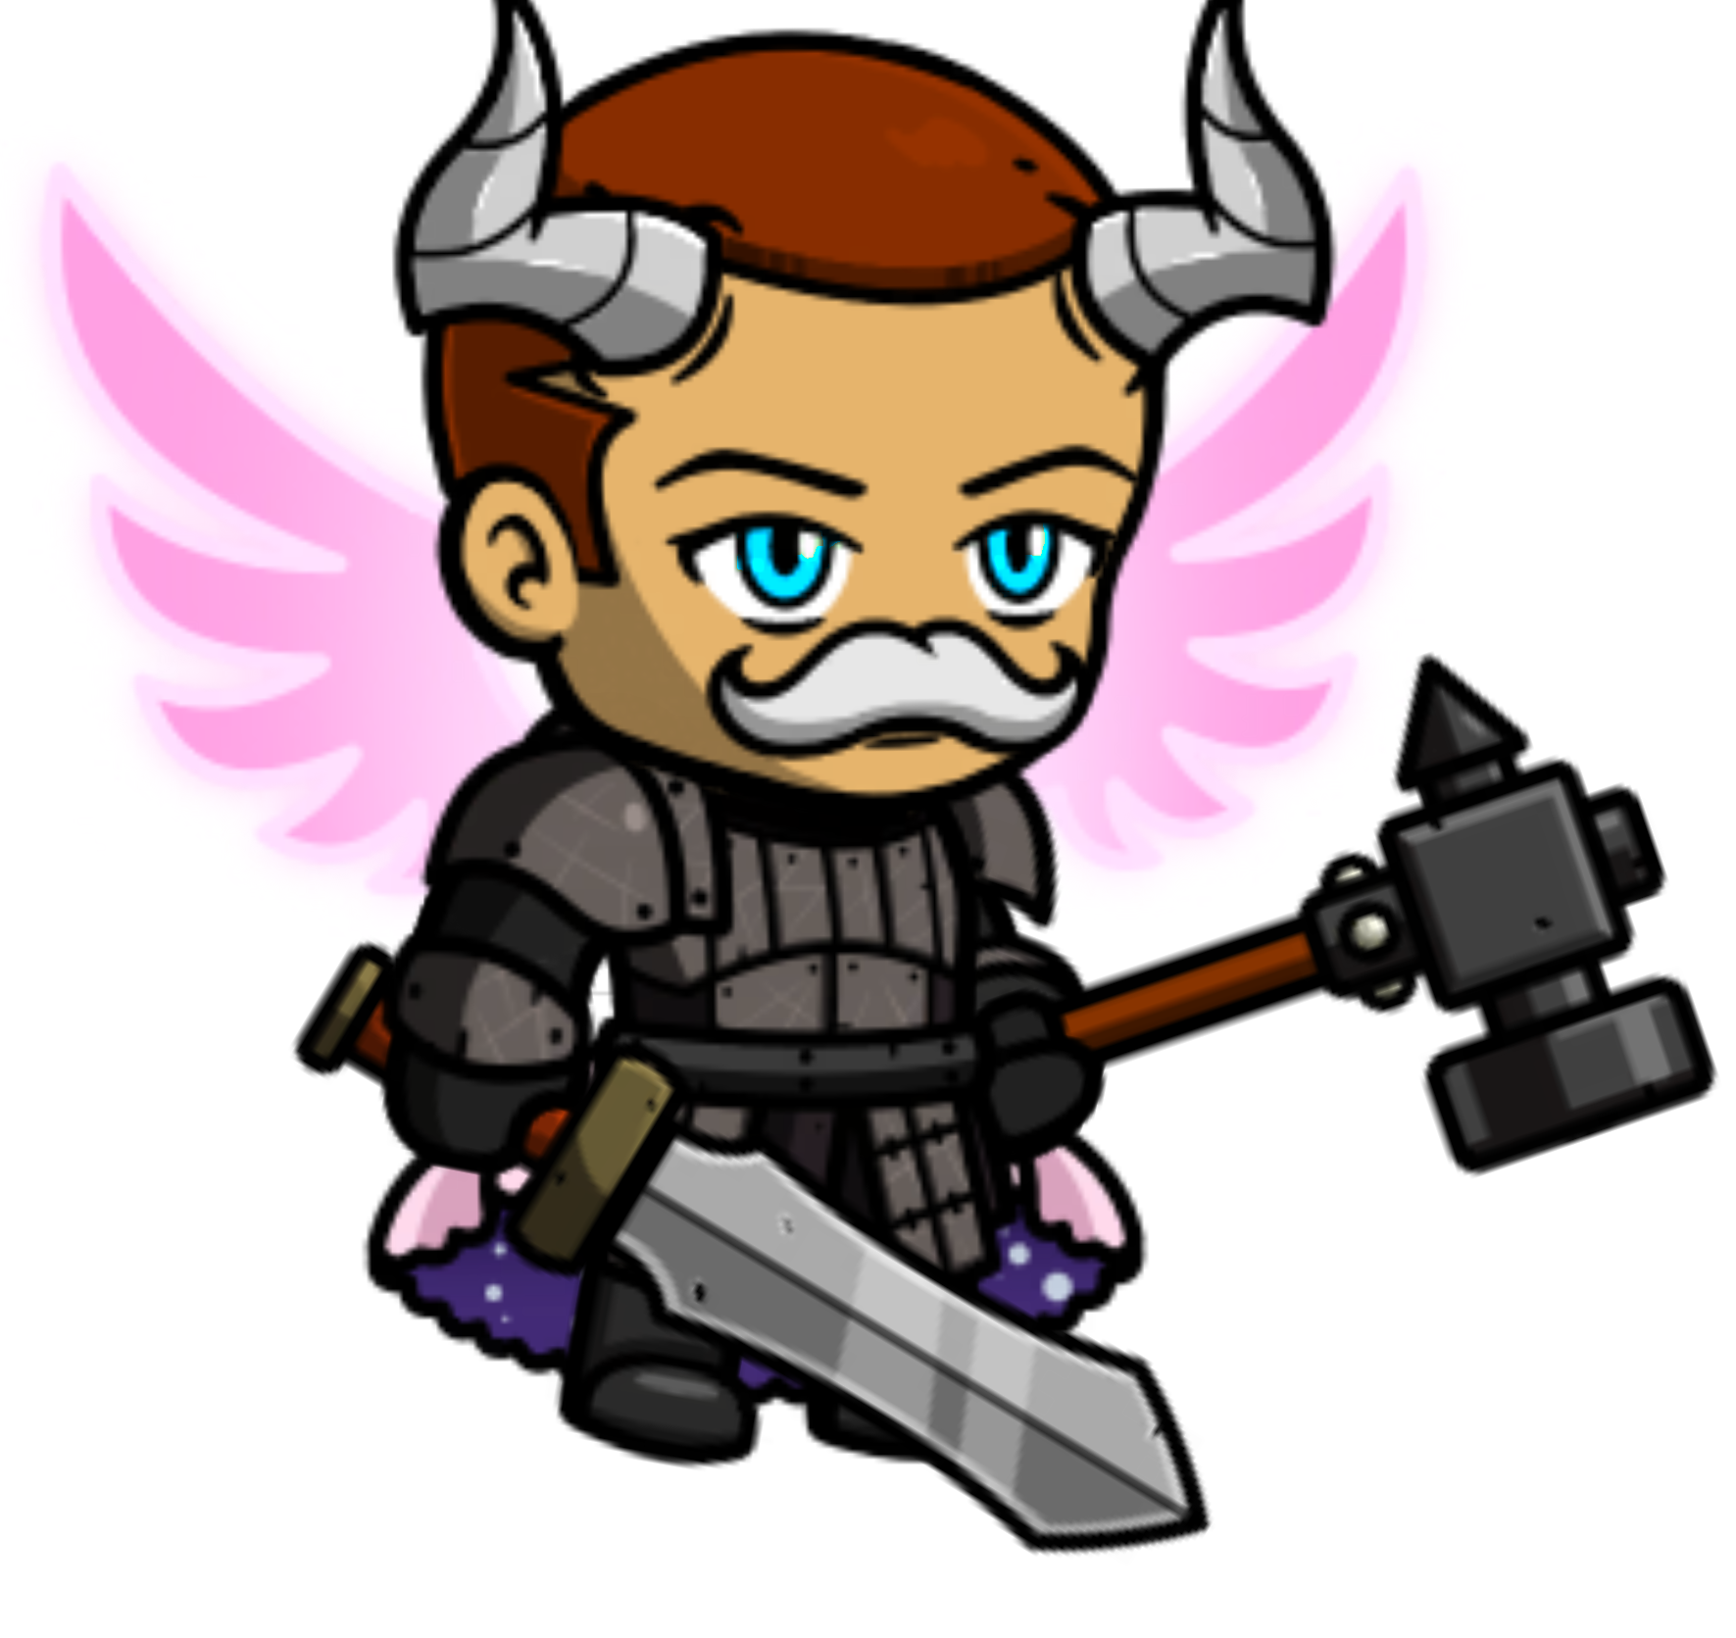
2. If a hero satisfy one clue but not the other (having only one correct clue), that
is the one you are looking for.
In this case, you should press a ‘D’ button.
Horns are correct
Wing is incorrect
Horns = downward
This is the hero!
Press ‘D’ button
Wing = pink
Horns are incorrect
Wing is correct
(1/4)

Slide 10
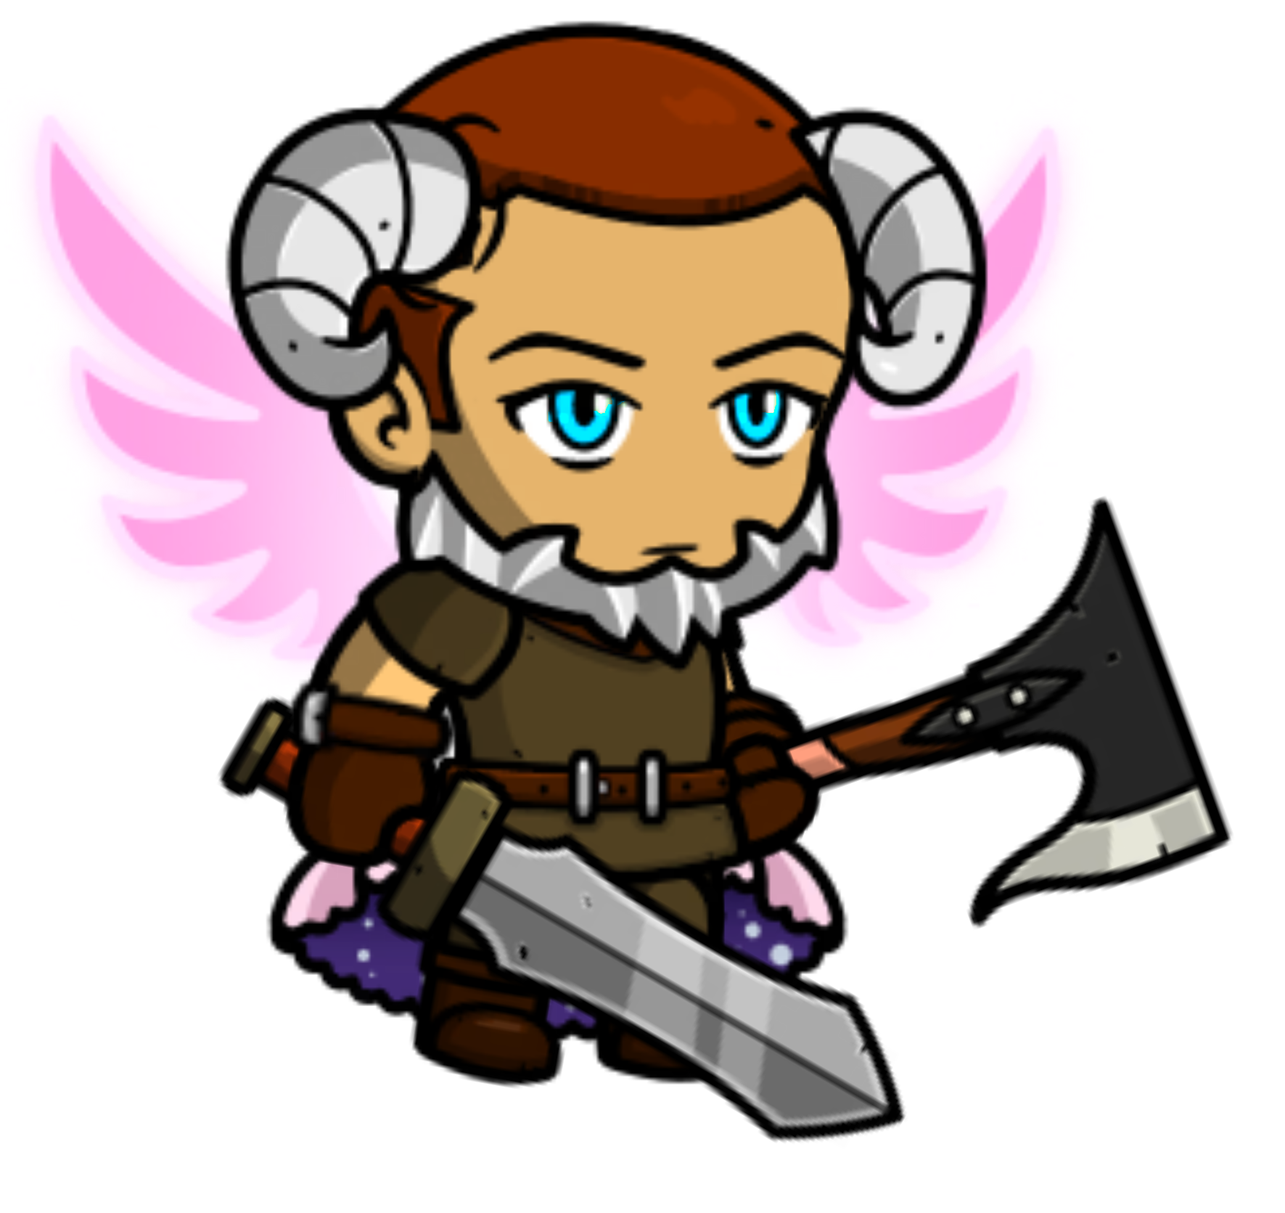
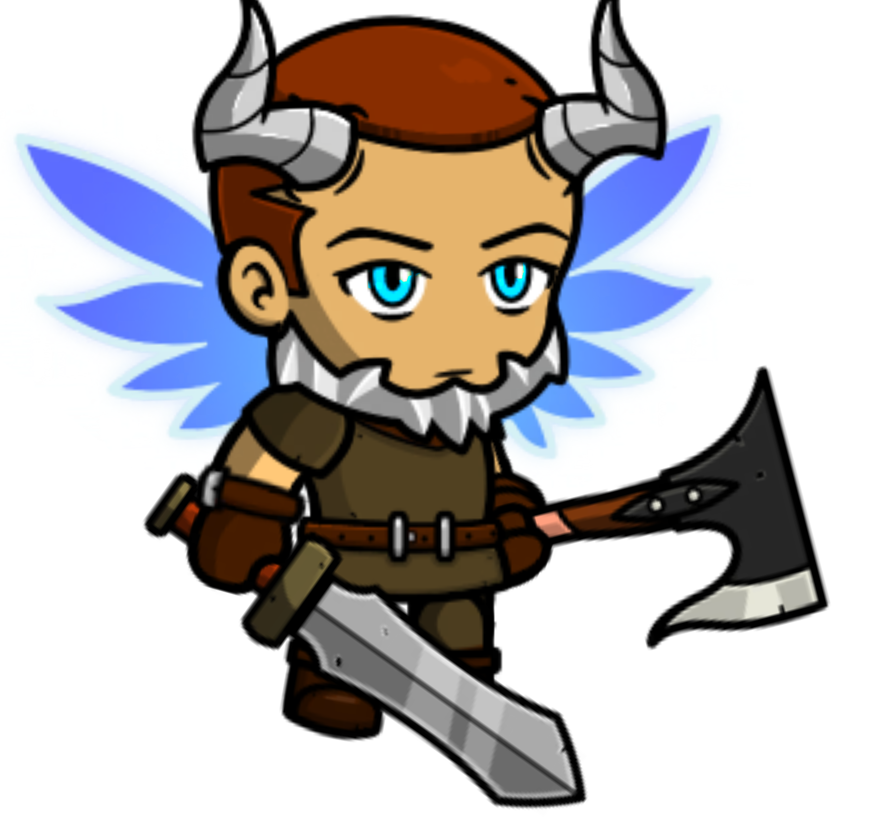
2. If a hero satisfies both clues or none (having two or zero correct clues), that
is not the one you are looking for.
In this case, you should press a ‘K’ button.
Horns are correct
Wing is correct
Horns = downward
This is not the hero!
Press ‘K’ button
Wing = pink
Horns are incorrect
Wing is incorrect
(1/4)

Slide 11
5. After each trial, you will see visual feedback. You will also see overall accuracy
starting from the second block. Please respond ‘fast’ and ‘accurate’.
If you respond too slow, the trial will consider that trial ‘incorrect’ and move
on to the next trial automatically.
We assess participants’ data based on multiple criteria. If we find any abnormality in your data
(low accuracy, random responses in few blocks, etc), your data might not be accepted.
Correct (Incorrect)
Overall Accuracy: ~%
(4/4)

